Slide 1
SHARP KPAYGL5C File
May 17, 2012
Payroll Services, Office of General Services

Slide 2
KPAYGL5C - Background
The SHARP KPAYGL5C is a data file that has existed since 1996, when SHARP was first implemented. Until now, only specific agencies have been receiving this file.
The purpose of this file is to provide agencies with all their payroll charges in a format that can be imported in Excel, Access, or other spreadsheet software.
The layout changed significantly in July, 2010 at the time of the SMART implementation.

Slide 3
KPAYGL5C - Overview
KPAYGL5C is distributed to agencies through Core FTP Pro, similar to other payroll and HR files.
The file is retained in Core FTP Pro for 30 days.
The information reflects the accounting transactions created in SHARP that correspond to every paycheck that is funded by an agency.
When paychecks are split funded between two different agencies, program logic splits and sends the funding lines to only the funding agency.

Slide 4
KPAYGL5C – Overview
Journal IDs on the funding lines are the same Journal IDs processed in SMART for payroll.
KPAYGL5C contains the detail rows for the journals that are summarized (by matching chartfields) and sent to SMART.
When funding information is changed in SMART due to journal edit errors or budget errors, these changes are not reflected on the KPAYGL5C.

Slide 5
KPAYGL5C – Timing of Files
KPAYGL5C is created two times each pay period
Following the on-cycle
Following the completion of Off-Cycle ‘C’
The timing for this file could be slightly different when holidays alter the processing schedule.

Slide 6
KPAYGL5C – Timing of Files
First File: The weekend of payroll confirm
Example: For the pay period ending April 28th, 2012, the first file was generated on Saturday, May 5th.
The first file does not include Journal IDs since the file is created prior to sending the data to SMART.
The first file includes only on-cycle paychecks.
Some agencies use this first file to get total expenditures for federal funds in order to request federal draw-downs.

Slide 7
KPAYGL5C – Timing of Files
Second File: Two days after Off-Cycle ‘C’ for the pay period
Example: For the pay period ending April 28th, 2012, the second file was generated on Wednesday evening, May 16th. Off-cycle ‘C’ was processed on Monday night, May 14th.
This file includes all activity for the pay period. It includes all transactions for the on-cycle and off-cycles A, B, and C.
Journal ID is included for all transactions.

Slide 8
KPAYGL5C – File Versions
Older Version:
Generated in a flat file format.
Does not contain column labels on the top row of the file.
Contains ALL accounting transactions, including expenditure, liability, and cash rows.
Contains every data field that is on the payroll accounting table, including many fields that are empty, and some fields that are not needed for agency use.
Many agencies using this version of the file have created macros in Excel to open and format the file, and even to eliminate some of the fields they don’t need.
Opening the file manually using Excel can be tedious. It is helpful to have the file layout to refer to in order to determine where column breaks need to be inserted.

Slide 9
KPAYGL5C – File Versions
Newer Version:
Generated in a comma delimited (CSV) file format.
Contains column labels in the top row for each data element.
Contains only expenditure accounting transactions.
Contains a subset of the data fields from the payroll accounting table. The fields that were eliminated in this version of the file were fields typically not needed by agencies.
Simple to open using Excel. Since the file is comma delimited, column dividers are inserted automatically.

Slide 10
KPAYGL5C – Roll-Out
Roll-out for new agencies is May 17th
Agencies previously not receiving this file will begin receiving it May 17th in the newer CSV format.
The new file appearing in Core FTP Pro on May 17th was processed during the May 16th SHARP batch cycle. This report includes all payroll expenditures for the pped 4/28/2012.
Agencies receiving KPAYGL5C prior to May 17th will continue to receive it in the format previously selected by the agency.
Any agency receiving the older version may request to switch to the CSV version of the file.

Slide 11
KPAYGL5C – Use of File
Suggested uses for the KPAYGL5C:
Information from the on-cycle payroll file can be used to help determine federal drawdown amounts.
Using this file in Excel, Access, or a similar application, agencies can sort, filter, and subtotal for any data element or group of data elements to meet the agency’s financial or budgetary needs.
KPAYGL5C replaces KPAYWAGE to get wage and fringe information by position number for a particular program code/funding source.
Filter information by Project ID to assist with special reporting needs associated with a project or grant.
Accumulate all KPAYGL5C files for the fiscal year to assist with obtaining Fiscal Year-To-Date budget information.

Slide 12
KPAYGL5C - Instructions
The next set of slides shows how to download and open the KPAYGL5C file using Excel.

Slide 13
KPAYGL5C - Instructions

Slide 14
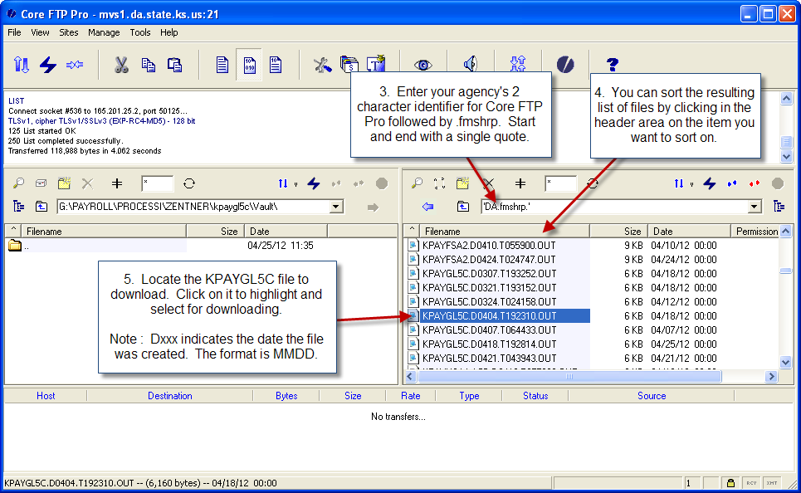
KPAYGL5C - Instructions

Slide 15
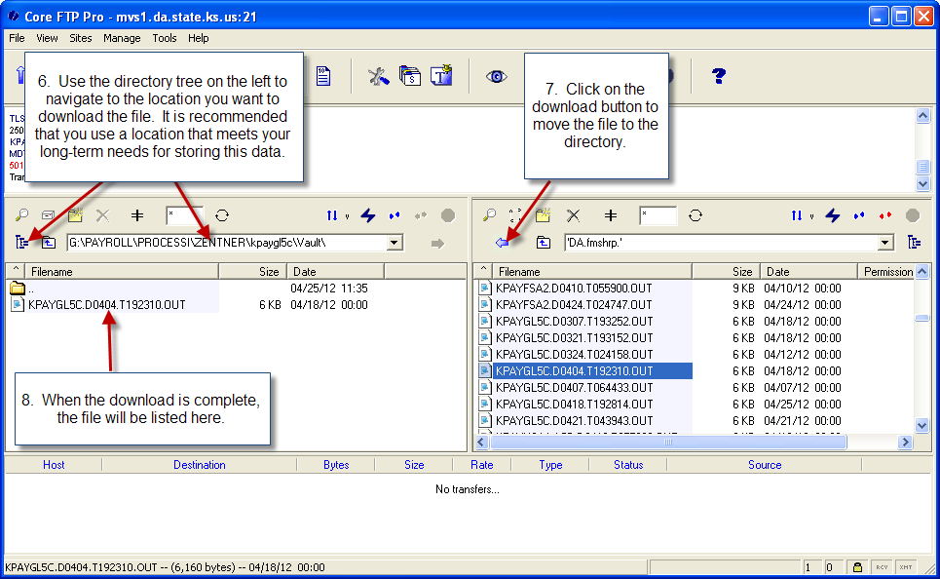
KPAYGL5C - Instructions

Slide 16
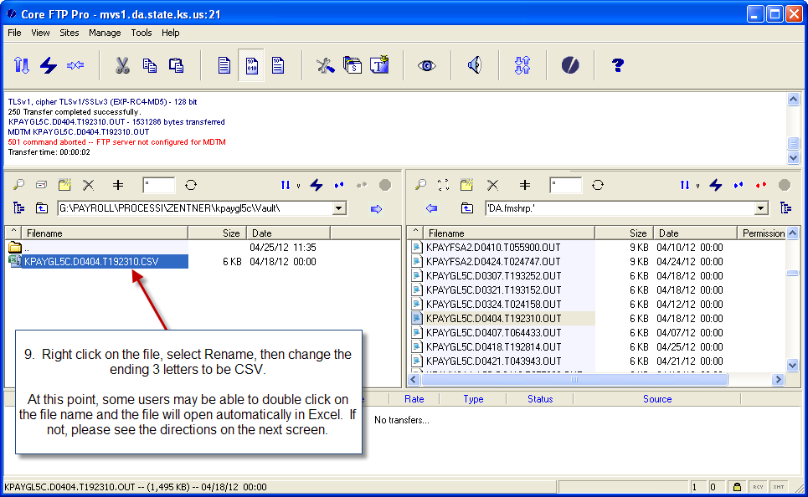
KPAYGL5C - Instructions

Slide 17
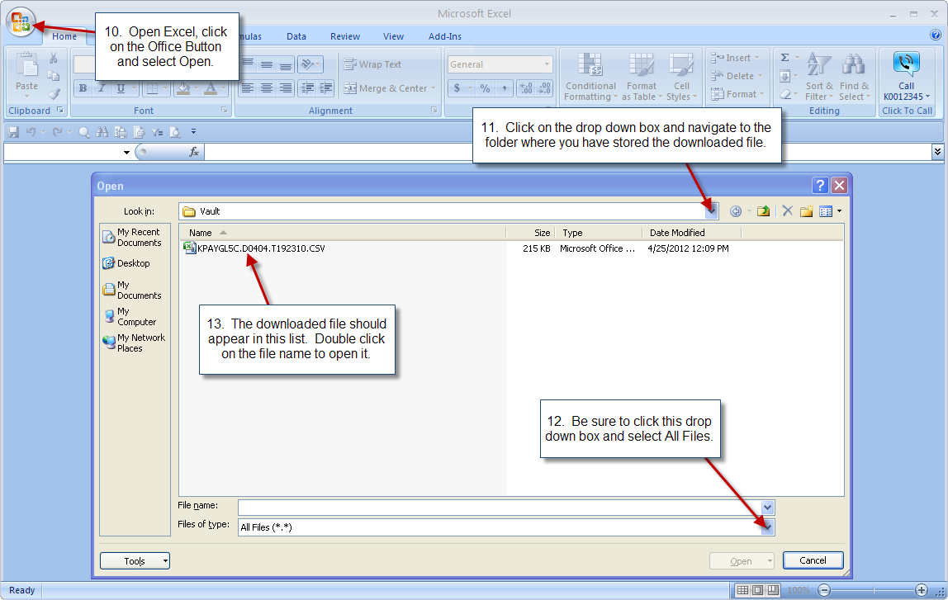
KPAYGL5C - Instructions

Slide 18
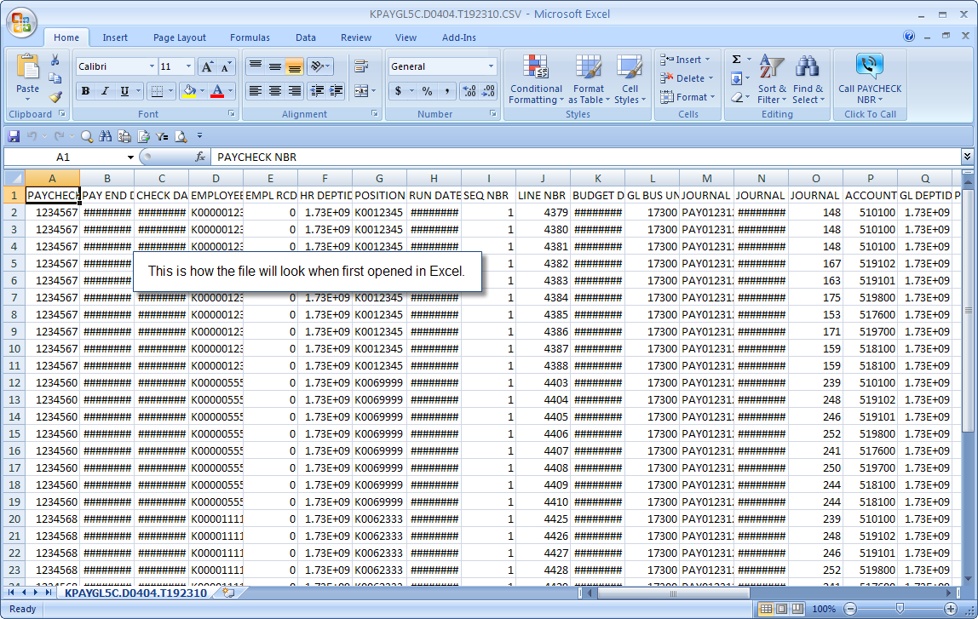
KPAYGL5C - Instructions

Slide 19
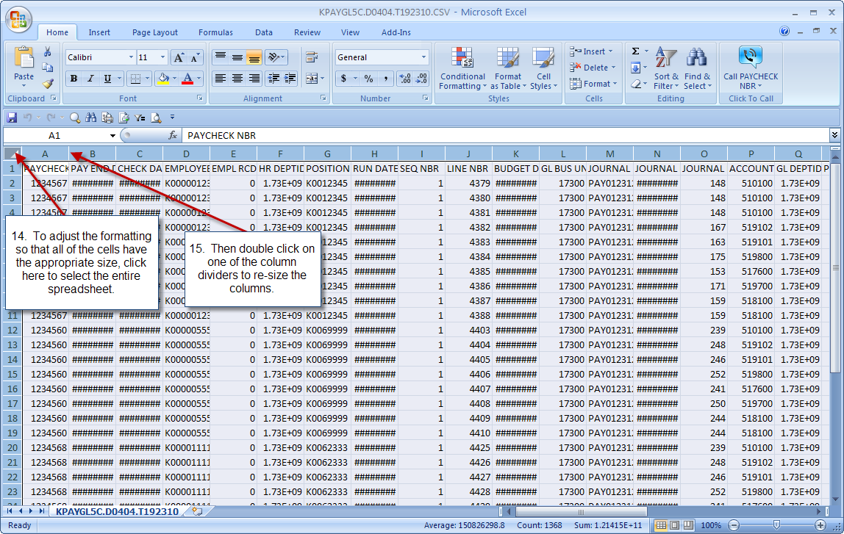
KPAYGL5C - Instructions

Slide 20
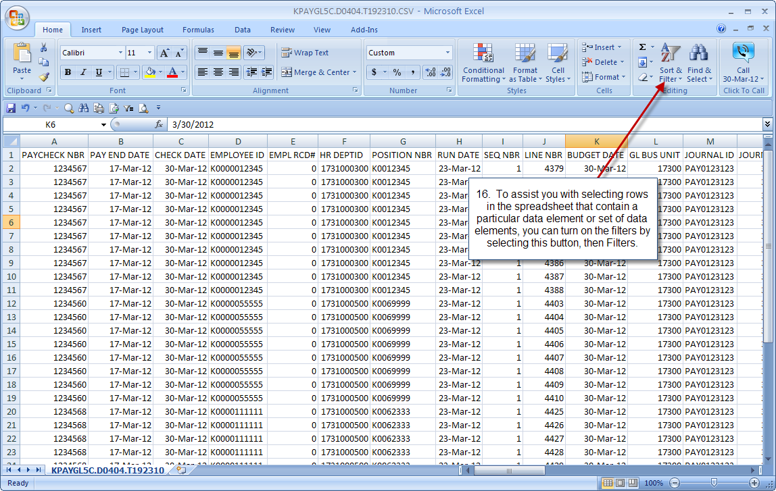
KPAYGL5C - Instructions

Slide 21
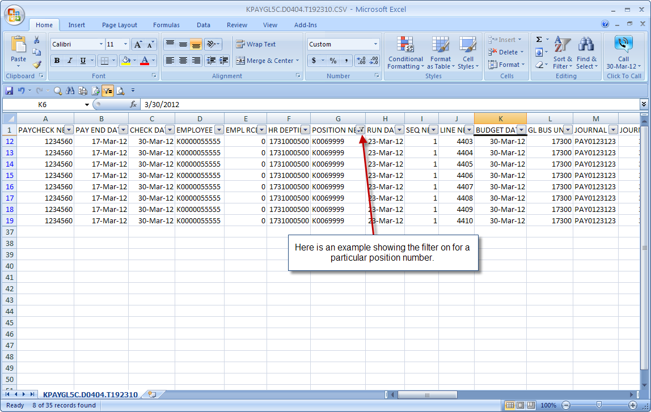
KPAYGL5C - Instructions

Slide 22
KPAYGL5C – Data Elements

Slide 23
KPAYGL5C – Tips & Tricks
Download the file within 30 days of the date the file was generated. The file will be deleted from Core FTP Pro after 30 days.
Use Outlook to set-up calendar reminders for the days the file needs to be downloaded. Agencies will be billed for special requests to re-generate old pay period files.
Save the original file in a secure location and create a working copy to store in a different folder. Use the working copy for any manipulation of the data.
Accumulate the KPAYGL5C files for fiscal year reporting and budgeting.
Import the file into Access where specific reports can be developed and maintained.

Slide 24
KPAYGL5C – Tips & Tricks
Optional: Track all changes (due to journal/budget errors) that are made to payroll journals in SMART and update KPAYGL5C to reflect those changes.
Optional: Track other journals that are processed in SMART to change funding for payroll expenditures, then add rows to KPAYGL5C for those journals.
Run query KS_GL_SALARIES_WAGES_EXPENSES in SMART to review/compare all payroll GL summary expenditures (account codes 51000-519900) . Query results include summarized journals for all expenditures detailed in KPAYGL5C file in addition to any ad-hoc agency payroll journals.
Consider additional Excel or Access training for staff in order to utilize more sophisticated functions for data manipulation.

Slide 25
KPAYGL5C – Info/Contacts
See Office of General Services Informational Circular 12-P-026 located at
http://www.da.ks.gov/ar/infocirc/fy2012/IC12p026.htm
The informational circular includes a layout of the data elements contained in the file.
Further assistance is available by contacting
Sunni Zentner, at Sunni.Zentner@da.ks.gov or
Lisa Kraus, at Lisa.Kraus@da.ks.gov

Slide 26
Questions
?

