Slide 1
SMART Service Desk
Operations to Serve You
05/17/2012

Slide 2
Did You Know
The Service Desk Provides an Announcement Page?
The Service Desk houses a library of SOLUTIONS that are available to EVERYONE?
The Service Desk Request contains ALL Conversations (Replies) between the Agency, the Service Desk Administrator, and the SMART Technician Assigned to your request?
The Service Desk Allows you to Attach Documentation?
There are specific forms available for specific purposes and which when used, expedite your requests?
Notes:
So why am I bringing up these topics?

Slide 3
SMART Service Desk Announcement Page
The Service Desk does indeed provide an Announcement Page
https://dahelpdesk.ks.gov/
Click on the HOME tab

Slide 4
SMART Service Desk Announcement Page
To view an Announcement, simply click on it

Slide 5
SMART Service Desk Announcements Page

Slide 6
There Are Solutions……
#344 - How Do I Use the SMART Help Desk Tool to Find Articles and Solutions?
#731 - Requisition will not source to a PO
#740 - Corrections for Vouchers Entered With the Wrong Accounting Date
#727 - Split PCard Transactions when using a Speedchart for default chartfield values

Slide 7
There Are Solutions……

Slide 8
There Are Solutions……
The list displays in order of solution number

Slide 9
There Are Solutions……
Or you can search by ‘Topic’

Slide 10
There Are Solutions……
All year end Solutions are being updated for the coming year end…
…and new ones are being added
Notes:
What if you do not have a signon to the Service Desk? How can you get to these SOLUTIONS?

Slide 11
There Are Solutions……
If you do NOT have access to the Service Desk, go to http://da.ks.gov/smart/ and click on the link to the SMART Solutions Knowledge base.
Note – No signon is needed in order to get to the Solutions from the SMART website.

Slide 12
There Are Solutions……

Slide 13
SMART Service Desk REPLY Feature
Replies are performed as a Response to a question asked in the Service Desk ticket
Replies are performed to provide additional information in the Service Desk ticket
Replies are performed to attach documentation to the Service Desk ticket
Replies are CONVERSATIONS and help to clarify the issue, request, or question at hand

Slide 14
SMART Service Desk REPLY Feature
When a SMART Team member enters a REPLY in a Service Desk Request, you, the Requester will receive an e mail such as the one below. The purpose of the e mail is to alert you that there is activity in your Service Desk Request. PLEASE DO NOT REPLY to the e mail.

Slide 15
SMART Service Desk REPLY Feature
Note the NOTE below! PLEASE DO NOT REPLY TO THIS E MAIL!

Slide 16
SMART Service Desk REPLY Feature
Replying to the e mail delays the assistance you receive. Why?
Your e mail is sent to the SMART Service Desk e mail in box
In order maintain a central location for this request, the email communication is copied and pasted from the Service Desk e mail into the Service Desk Request. The technician assigned to your request will not see your correspondence until this copy and paste is performed.
Notes:
So what should you do instead?

Slide 17
SMART Service Desk REPLY Feature
Get into the SMART Service Desk and perform a REPLY IN THE TICKET!

Slide 18
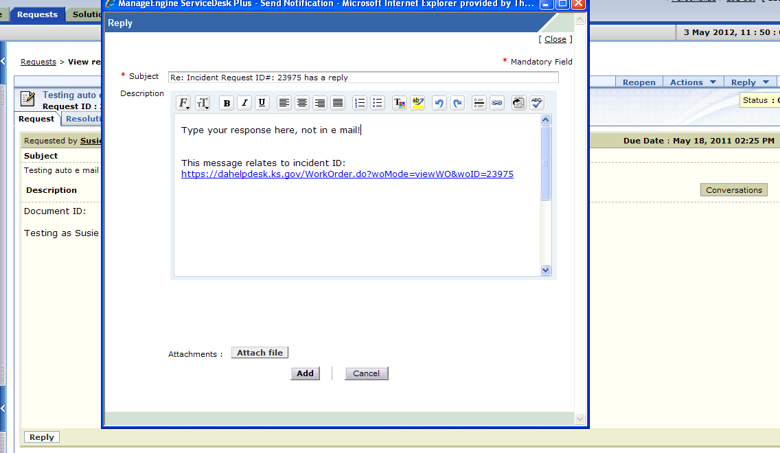
SMART Service Desk REPLY Feature
Enter your communication in the area provided in the request, click ADD

Slide 19
SMART Service Desk REPLY Feature
Your communication is now date and time stamped in the Service Desk ticket!

Slide 20
Attaching Documentation to a Request
Attaching documentation adds another element to providing clear and concise communication
The more documentation provided, the more accurate is the communication
Documentation can provide specific examples

Slide 21
Attaching Documentation to a Request
The Service Desk Request you create is the communication tool for numerous teams.
Include screen shots
Attach report examples
Include the appropriate form to accompany your request
Include any documentation that will help the SMART Team resolve your request quickly and accurately.

Slide 22
Attaching Documentation to a Request
When the request is new

Slide 23
Attaching Documentation to a Request
Scroll down
Click ‘Attach File’

Slide 24
Attaching Documentation to a Request
Click on Browse to find your file
Then attach it

Slide 25
Attaching Documentation to a Request
What if you forgot to attach the documentation at the time the request was logged?

Slide 26
Attaching Documentation to a Request
Click REPLY
Then click ‘Attach File’

Slide 27
Attaching Documentation to a Request
Find the file
Then click ‘Attach File’

Slide 28
Attaching Documentation to a Request
Click ADD
Click ADD

Slide 29
Attaching Documentation to a Request
Note that your communication is saved and is available in the REQUEST.

Slide 30
Attaching Documentation to a Request
As is the documentation
Notes:
What did we accomplish?

Slide 31
Attaching Documentation to a Request
You have now accomplished adding CONVERSATION and DOCUMENTATION to your REQUEST!
The Help Desk Contact at the Agency has access to all communications and documentation involved in this Request
The SMART Team has access to all communications and documentation involved in this Request
Archiving is complete for historical reference purposes

Slide 32
Forms & The Service Desk

Slide 33
Forms & The Service Desk Agency Request Form
For new functionality in SMART or changes to existing SMART functionality – Agency Request Document
http://www.da.ks.gov/ar/pm/Forms/Default.htm
New report
New functionality
Enhancements

Slide 34
Forms & The Service Desk Agency Request Form
Notes:
Fill out the form and ATTACH it to the Service Desk Request!

Slide 35
Forms & The Service Desk Security Related Forms
http://da.ks.gov/smart/technicalresources.html

Slide 36
Forms & The Service Desk LINKS
JOB AIDS - http://da.ks.gov/smart/Training/CourseMaterials/WBT/resources.html
Security Forms, Data Entry Templates, Reports, Interface Trouble Shooting - http://da.ks.gov/smart/technicalresources.html
Training - http://da.ks.gov/smart/training.html
SMART Ready Forms; Agency Request Document, Department ID Change, Encumbrance Request, InterUnit Transfer, etc. - http://www.da.ks.gov/ar/pm/Forms/Default.htm

Slide 37
I DID SEND A REPLY!! What do you mean it is not in the Request?
Are you kidding me? Did you really say RESUBMIT?
What? I need to attach an Agency Request Form? You all are ‘form form forming’ me to death!

Slide 38
SMART Service Desk Operations Serving You

