Slide 1
Protecting Your Customers’ Card Data ASTRA Presentation 05.14.2013 Brian Chapman and Peter O’Rourke

Slide 2
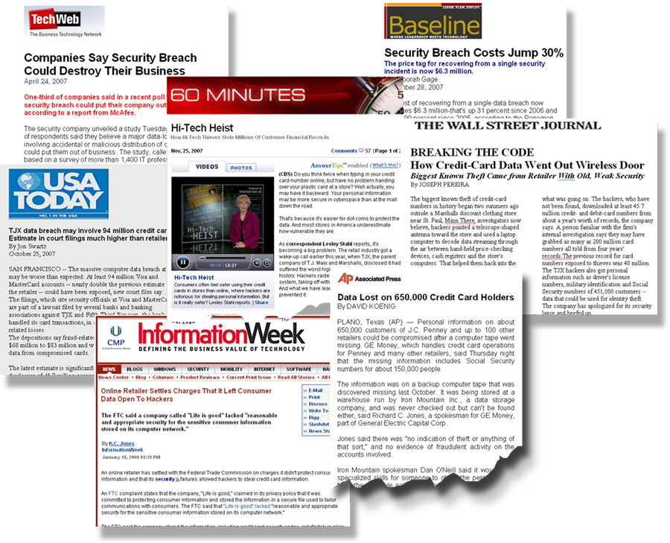
Data Compromises In the News

Slide 3
Common Causes of a Breach or Compromise
Trivial and common passwords for POS systems
Not changing the vendor-supplied password upon installation
Outdated antivirus software definitions
Use of vulnerable or non-compliant software
Remote access to systems by third-party providers
Having remote access turned on at all times

Slide 4
What is PCI?
PCI stands for the Payment Card Industry and is used to refer to:
The PCI Security Standards Council ™(PCI SSC), an industry body founded by the major card brands to protect cardholder data. Founders:
The global Security Standards created and maintained by the PCI SSC to protect cardholder payment data.
Important: Compliance with PCI Security Standards is mandatory for merchants and their service providers, and is enforced by the major card brands that established the PCI SSC.

Slide 5
Determining Your PCI Level and Validation Requirements

Slide 6
A Closer Look at the PCI DSS–Requirements
All card-accepting merchants must comply with all applicable requirements, below.
Important: Not all PCI DSS requirements apply to all merchants. Merchants must review each requirement to determine applicability to the merchant’s card payment acceptance systems and business processes.

Slide 7
PCI Level 4 Support Program

Slide 8
PCI Level 4 Support Program cont…

Slide 9
Enhancing Data Security and Reducing Your PCI Scope
Point-to-Point Encryption (P2PE)
Encryption is designed to protect cardholder data from the point of data entry.
Uses a key management feature making cardholder data unreadable to anyone that does not have the encryption key.
Protects Cardholder Data in Transit
If properly implemented, P2PE can reduce your scope of PCI DSS validation.
Tokenization Technology
Replaces cardholder data (PAN) with surrogate values (Token)
Designed to work in concert with encryption to eliminate storage of cardholder data
Allows merchant to limit the storage of cardholder data with the tokenization system
If properly implemented, tokenization can reduce your scope of PCI DSS validation
EMV Chip Technology
Protects against counterfeit cards by replacing static data with dynamic
Works with card-present transaction only
Requires a dual processing terminal (mag stripe and chip)

Slide 10
PCI Reference Websites
PCI Security Standards Council: https://www.pcisecuritystandards.org
PCI Mobile PA-DSS FAQs: https://www.pcisecuritystandards.org/documents/pa-dss_mobile_apps-faqs.pdf
Point 2 Point Encryption: https://www.pcisecuritystandards.org/documents/P2PE_Hardware_Solution_%20Requirements_Initial_Release.pdf
PCI DSS Tokenization Guidelines: https://www.pcisecuritystandards.org/documents/Tokenization_Guidelines_Info_Supplement.pdf
Approved Scanning Vendors and Qualified Security Assessors: https://www.pcisecuritystandards.org/qsa_asv/find_one.shtml
Validated List of Payment Applications: https://www.pcisecuritystandards.org/security_standards/vpa/
List of PCI SSC Approved PIN Transaction Security Devices: https://www.pcisecuritystandards.org/security_standards/ped/index.shtml
Navigating the PCI DSS: https://www.pcisecuritystandards.org/documents/navigating_dss_v20.pdf
Visa CISP: www.visa.com/cisp
MasterCard SDP: www.MasterCard.com/SDP
Discover DISC: http://www.discovernetwork.com/fraudsecurity/disc.html
American Express DSOP: https://www209.americanexpress.com/merchant/singlevoice/dsw/FrontServlet?request_type=dsw&pg_nm=merchinfo&ln=en&frm=US

Slide 11
Protecting Cardholder Data: The TransArmor® Solution

Slide 12
Introducing the TransArmor Solution
TransArmor is an easy-to-implement service that helps protects merchants and card data using a multi-level defense:
Combines encryption and tokenization to protect data at every processing stage
Depending on version, uses technology from RSA, the global leader in IT security, or combined technology from RSA and VeriFone
Removes payment card information from the merchant by replacing the Permanent Account Number (PAN) with a card-based “token”
Maintains all the merchant’s business benefits of storing the payment card data without the associated risk
Delivered as part of the payment processing service

Slide 13
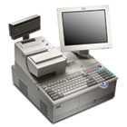
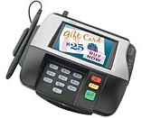
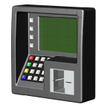
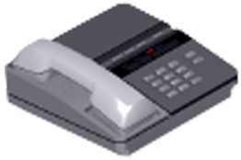
How Does It Work?
Merchant
Bank of America
Merchant Services
Card Present
POS
& Backoffice
Payment
System
Encrypted
Card Data
Petroleum
Processing
Card Not Present
Token
Call Center
Card Vault
E-Commerce

Slide 14
What Is Tokenization?
Tokens protect data at rest and in use.
Form of data substitution replacing sensitive PAN values with non-sensitive, randomly-generated token values
Differ from encryption: tokens have no direct relationship with the data they replace
Match the format of the initiating PAN – if PAN is 16 digits, token is 16 digits
Do not overlap major brand (Visa, MC, AMEX, Discover) BIN ranges (first digit is 0-2 or 7-9)
Do not pass MOD-10 or Luhn checks
Card-based, meaning they have a 1:1 relationship with an account number - same token will always be returned for a specific PAN
Do not expire - same token follows the card through the entire card lifecycle
Bank of America Merchant Services 14

Slide 15
What Makes TransArmor Different?
Important Points of Differentiation | TransArmor
Combines end-to-end encryption and tokenization, rather than relying solely on encryption alone (which protects data only while in transit but not when in use or at rest)
Minimizes IT resource allocation to implement and typically involves little-to-no new hardware in most cases, changes to back-end IT systems, or employee training
Completely removes sensitive data from the environment, thus reducing the scope of PCI compliance. (Encryption and in-house tokenization solution cannot remove the data from the merchant environment)
Flexibility to choose a software- or hardware-based model makes it easier to integrate—no new hardware or software is required, it is scalable as compliance rules change, and it is not a bolt-on product that requires a third- party vendor to touch the payment process
✔
✔
✔
✔
Bank of America Merchant Services 15

Slide 16
EMV Cards

Slide 17
EMV
EMVCo (Europay®, MasterCard® and Visa ®) is an organization that was formed to manage, maintain and enhance chip specifications for payment, ensuring interoperability globally.
EMVCo.com is the public portal for all things EMV.
EMV cards, also known as chip-based cards, contain an embedded microprocessor.
The microprocessor chip carries the business rules and authentication needed by the card for payment, and is protected by various security features to make it tamper-resistant.
Chip technology greatly reduces a criminal's ability to create counterfeit cards by introducing dynamic values for each transaction.

Slide 18
Card Brand Adaption and Timeline
VISA
MasterCard
Discover (Diners Club and PULSE)
American Express
October 2012
Tech Innovation Program (TIP)
Introduction of MasterCard
PCI DSS Compliance Validation Exemption Program
Discover Authorization Interface-Partial Chip Card transaction indicator introduced
Discover expands EMV program to include Contactless
Acquirer Mandates
April 2013
U.S. Acquirer Processors to support chip processing
U.S. Region acquirers must be capable of processing MasterCard contact and contactless chip transactions
Acquirer & Direct Connect Merchant Support for Discover’s EMV-compliant payment specification (D-PAS)
U.S. Processors must be able to support American Express EMV chip-based contact, contactless and mobile transactions.
October 2013
Potential Reduction of Calculated Account Data Compromise Operational Reimbursement and Fraud Recovery
PCI Data Security Relief
October 2015
Liability Shift for credit and debit domestic and cross border transactions
Chip and Chip / PIN liability shift participation
Additional Potential Reduction of Calculated Account Data Compromise Operational Reimbursement and Fraud Recovery
Liability Shift
Liability Shift
October 2017
Liability Shift for automated fuel dispensers
Chip and Chip / PIN Liability shift for automated fuel dispensers
Liability Shift for automated fuel dispensers
Liability Shift for automated fuel dispensers

Slide 19
Q & A—We’re standing by to answer your questions.

